Slide 1

MidTerm Report:
Computerized Automatic Rapid Deck Sorter (CARDS)
Emily Gensch CPE, Henry Abshire CPE,
Benjamin Harris EE, Nicholas Heikes CPE
Group 19

Slide 2
MidTerm Report:
Part 1: Product Design
Part 2: Key Engineering Specifications
Part 3: Overall Functionality Demonstration

Slide 3
PART 1: Product Design

Slide 4
Basic Design:
Mechanical:
Motor wheels
Car flipper
Rototation
Software:
Card position detection
Electrical:
Power and PCB

Slide 5
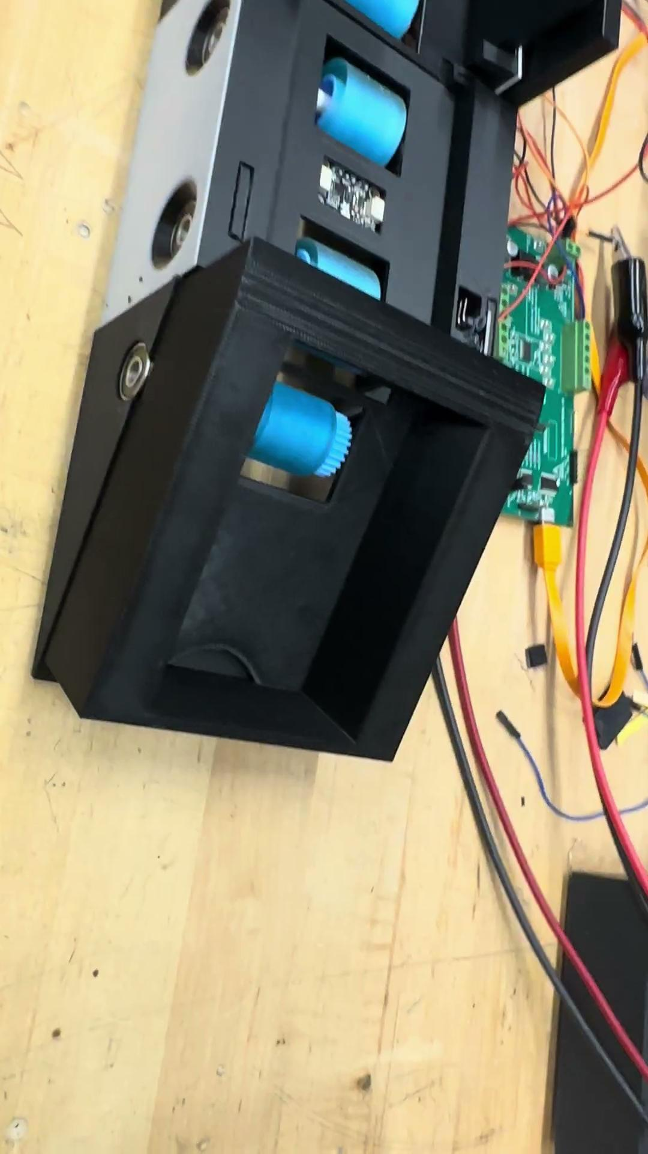
Basic Design:

Slide 6
PART 2: Key Engineering Specifications

Slide 7
Key Engineering Specifications
Specification | Description | Target
Multiple Card Error Rate | The minimum rate at which the device draws multiple cards into the system simultaneously. | No more than 90%
Bill Detection Accuracy | Rate at which the system's sensors accurately detects the bill at the point of input. | At least 98%.
Color Processing Time | The minimum time at which the card color is detected and identified. | Less than 100 milliseconds
Card Orientation Time | The speed that the card will either flip length\widthwise | Less than 2 seconds

Slide 8
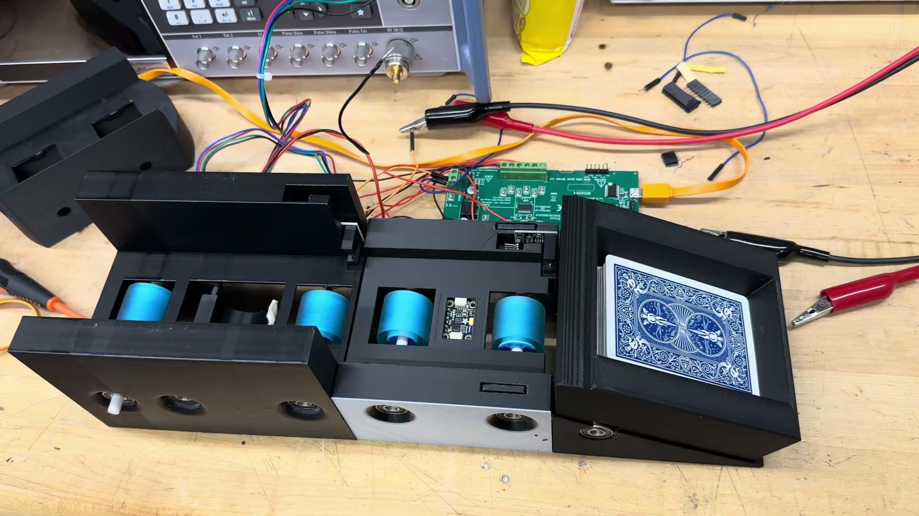
Multiple Card error Rate

Slide 9
Multiple Card error Rate
# of Cards | OverLapping Cards on Color Sensor
33 | 1

Slide 10
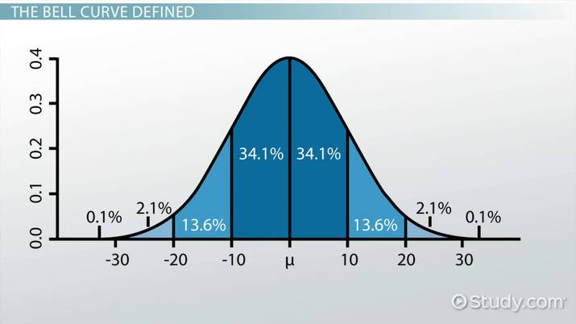
2: Bill Detection Accuracy: Bill Detection Table of Stats
Score Type
BlueBack
RedBack
Minion Club
Minion Heart
Minion Spade
Minion Diamond

Slide 11
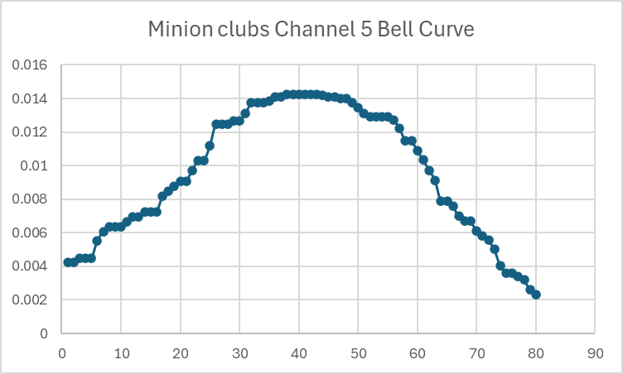
2: Bill Detection Accuracy: Bill Detection Algorithm
Score Type | Score
BlueBack | 2
RedBack | 1
Minion Club | 7
Minion Heart | 3
Minion Spade | 5
Minion Diamond | 5

Slide 12
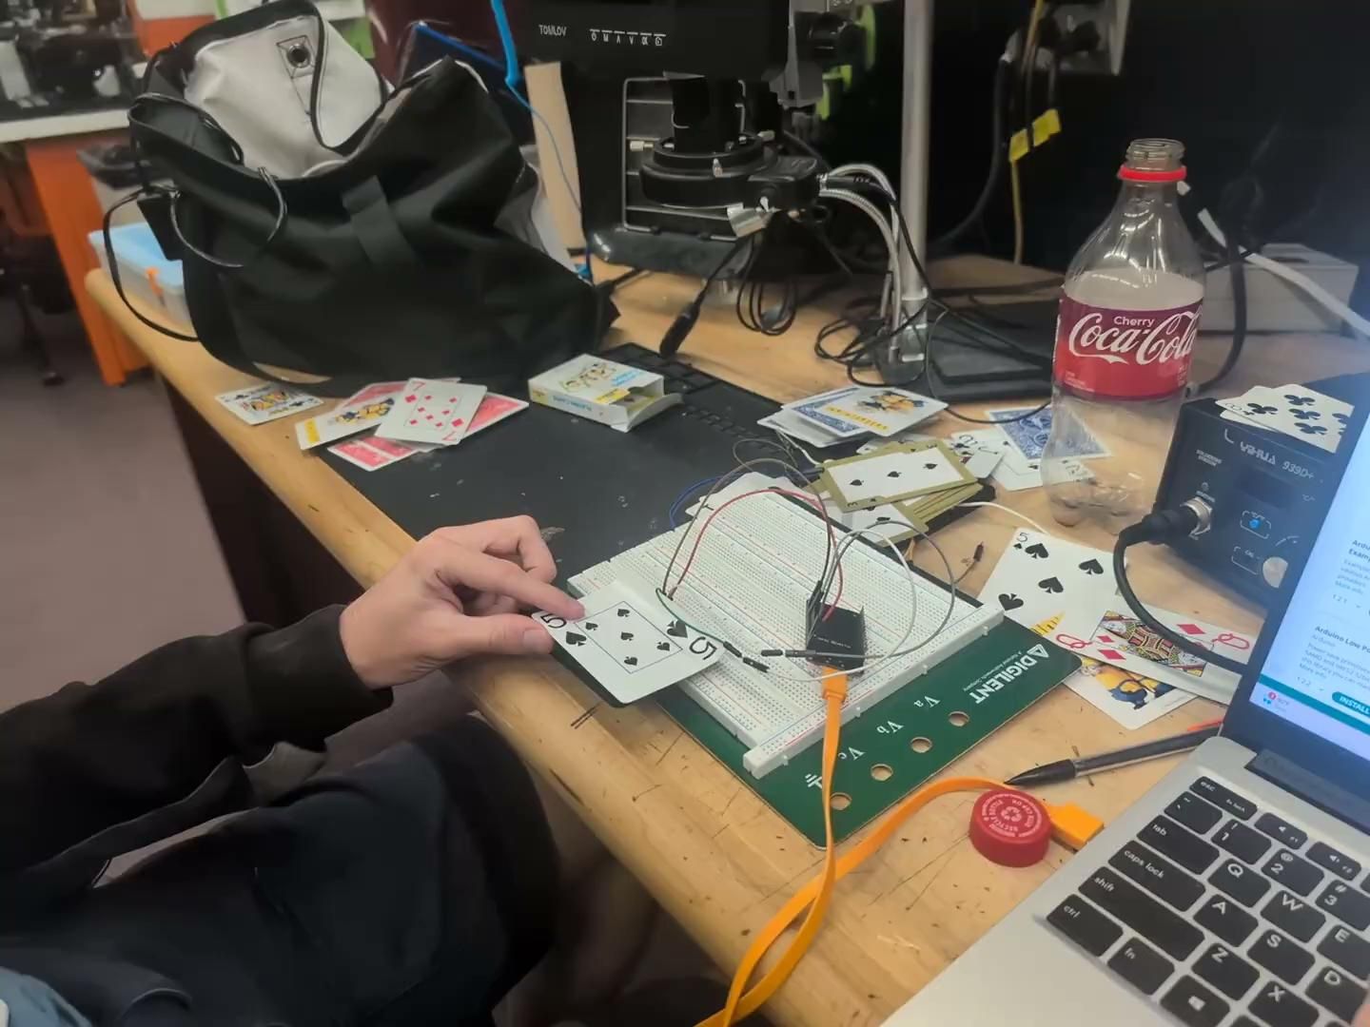
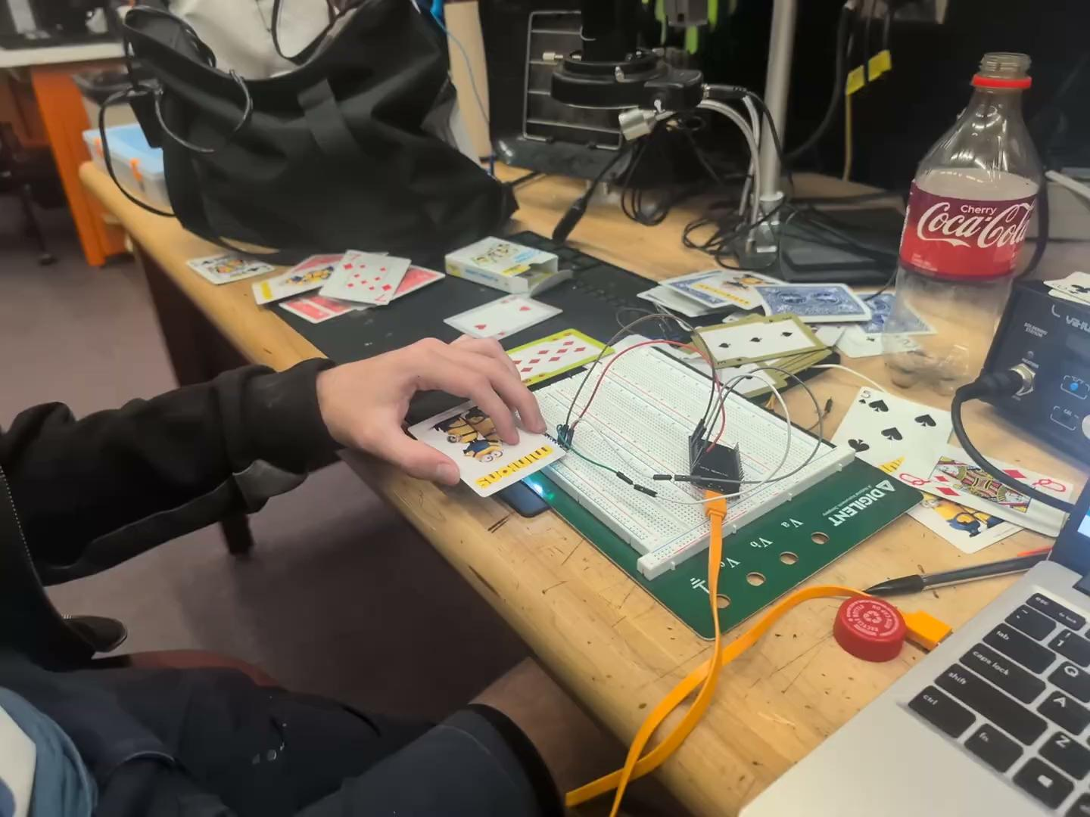
2: Bill Detection Accuracy: Demonstration

Slide 13
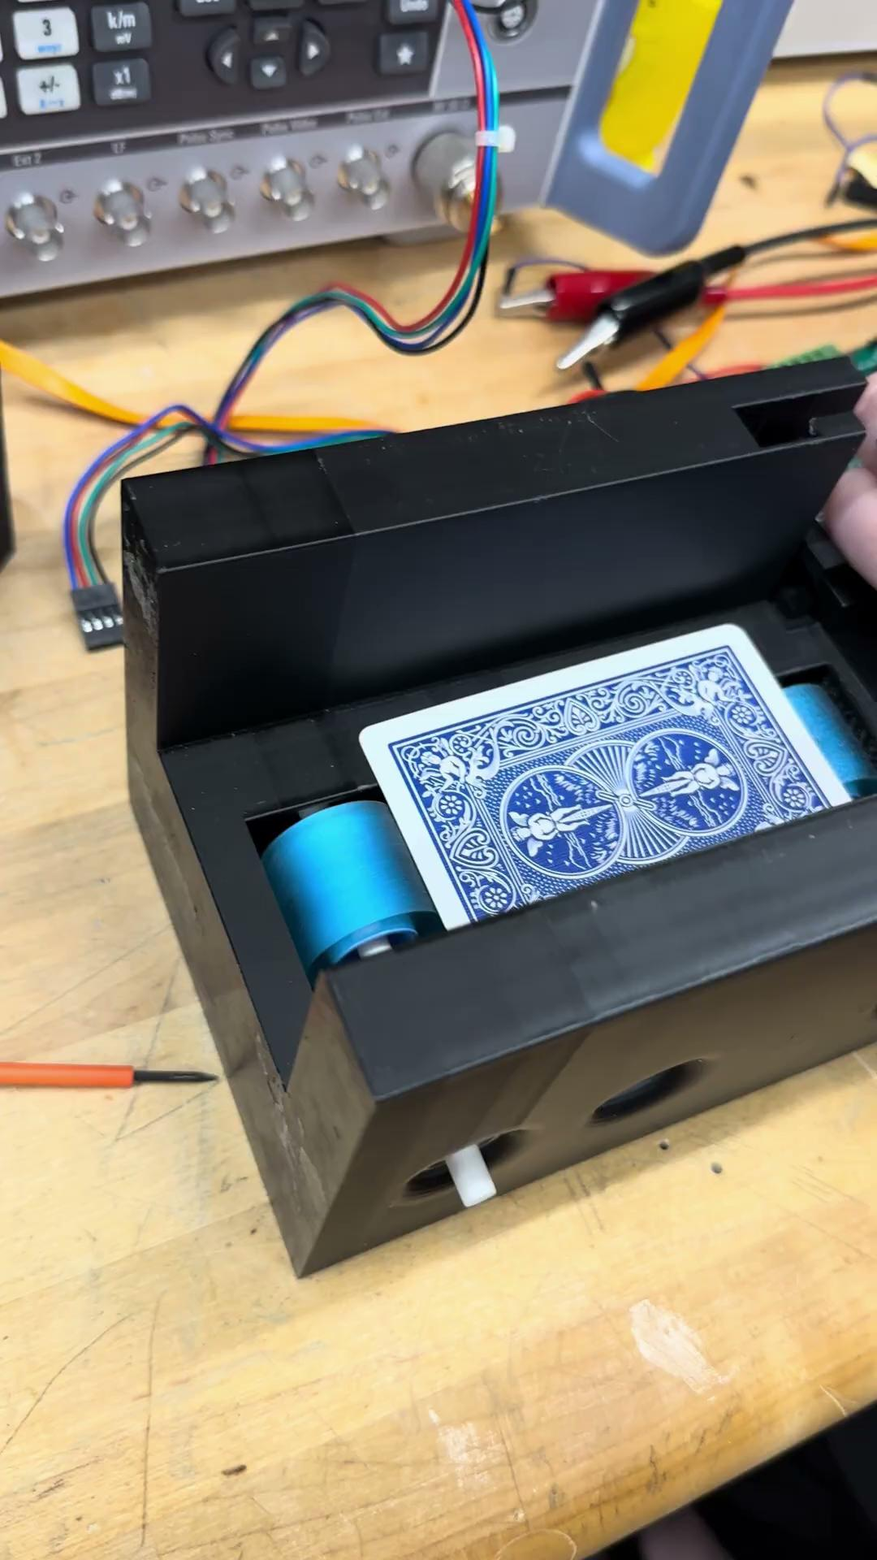
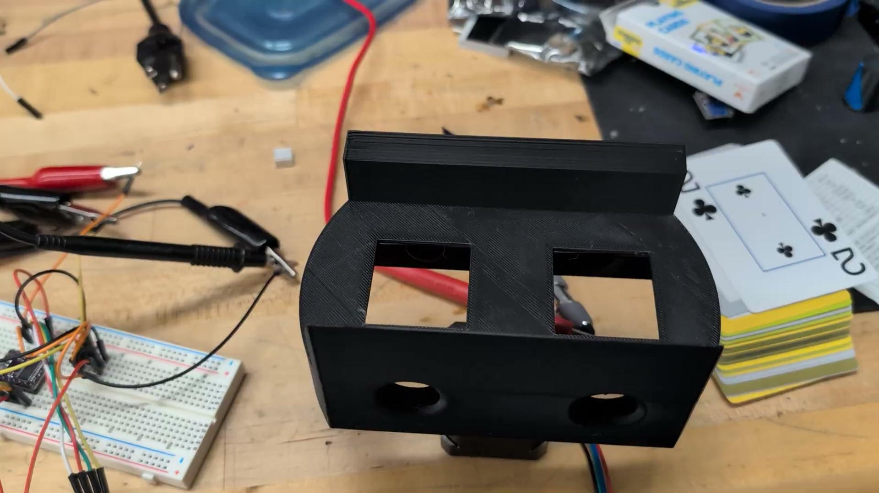
4: Card Orientation Time
Horizontal Flipper: time ~ .4s

Slide 14
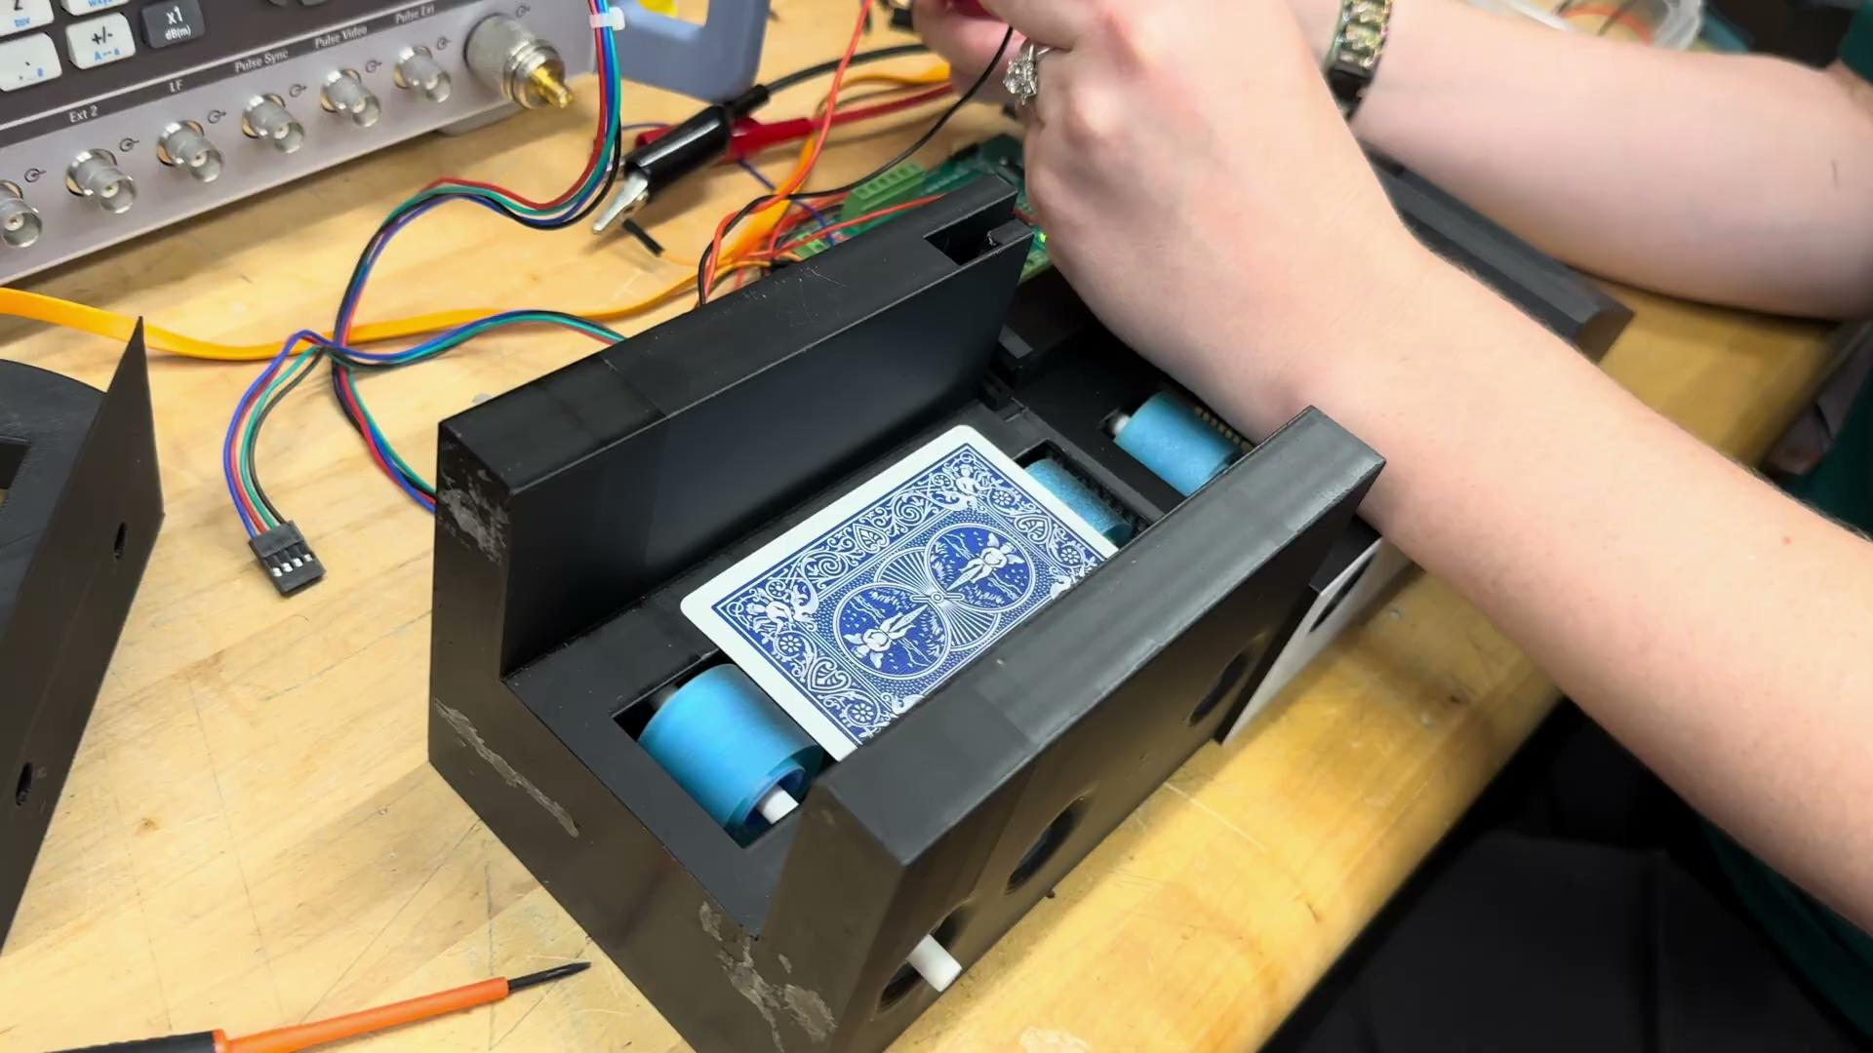
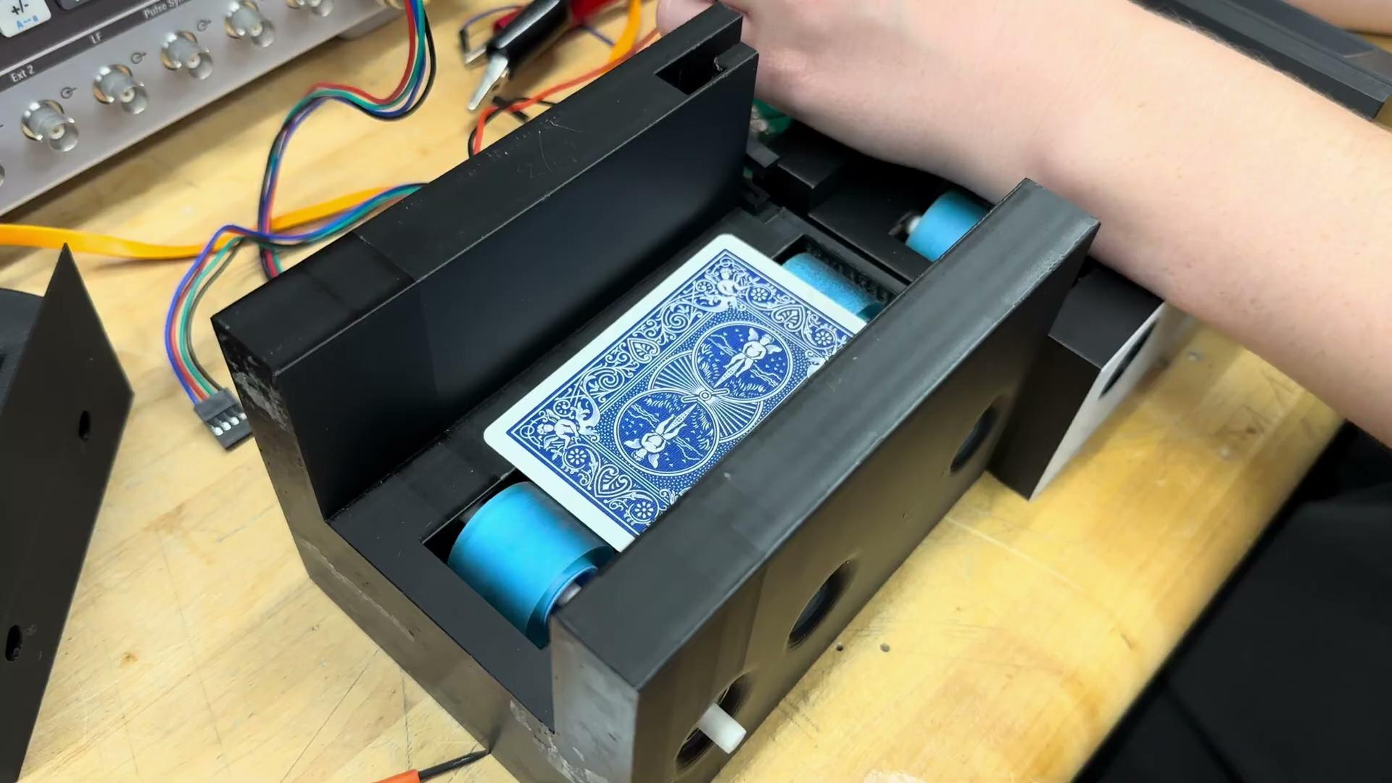
4: Card Orientation Time
Vertical Flipper: 70% success rate, time ~ 0.5s on average

Slide 15
PART 3: Overall Functionality Demonstration

Slide 16
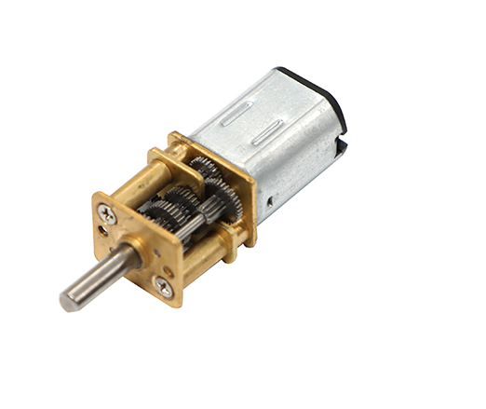
Functional Part: Servo Motor
The G12 N20 Geared Mini DC Motor powers the rollers in our system ensuring the cards are pushed through the design at the appropriate speeds.

Slide 17
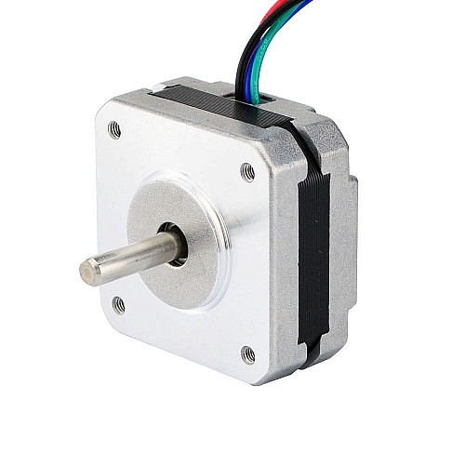
Functional Part: Stepper Motor
The 17HS09-1004S Stepper Motor powers the rotational aspect of our design, allowing the system to fix the horizontal orientation of cards.

Slide 18
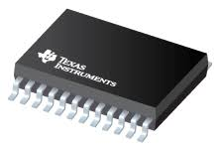
Functional Part: Servo Motor Driver DRV8912-Q1 – 12 Channel Brushed DC Motor Driver
The DRV8912 is a motor driver with 12 half bridges, thus allowing it to power and control up to 6 servo motors individually. Two are used to control the 10 motors in our design

Slide 19
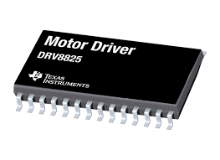
Functional Part: Stepper Motor Driver DRV8825
The DRV8825 is a Stepper motor driver with 8 different options for step length. It is used to control the stepper motor.

Slide 20
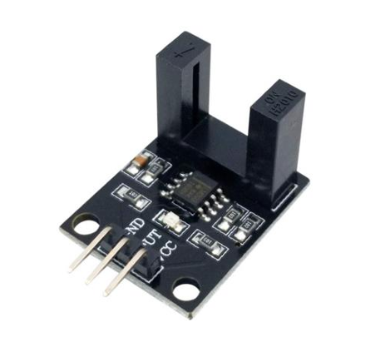
Functional Part: H2010 & LM393 IR Sensor
The H2010 is a ir trip wire sensor with a LM393 voltage comparator to allow the esp32 microcontroller to read a broken signal. It is used to determine when cards are jammed in the system

Slide 21
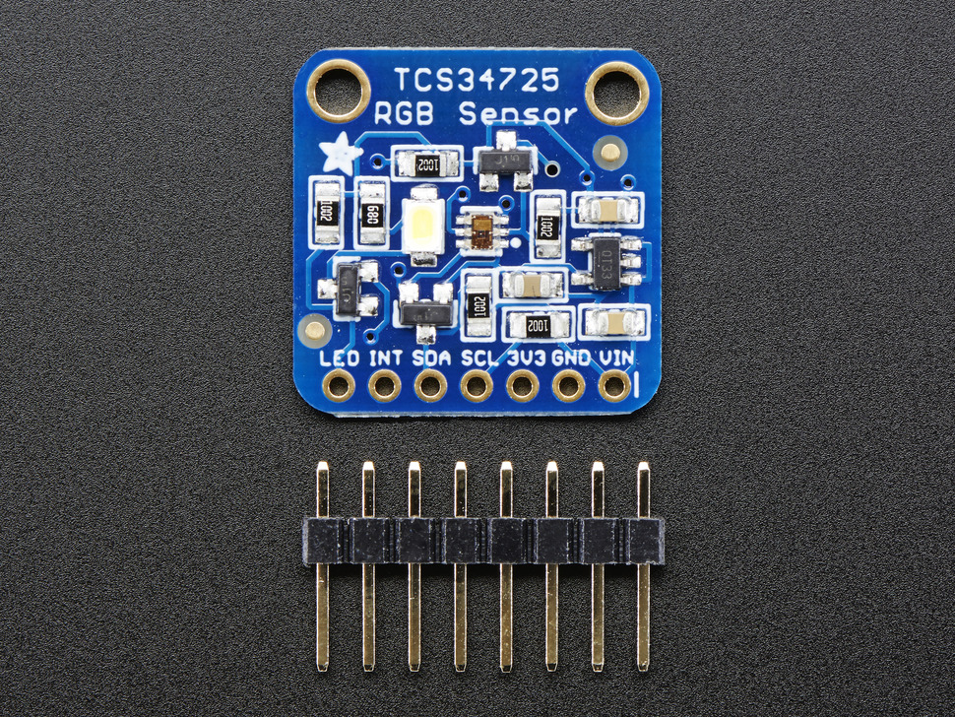
Functional Part: TCS34725 -Ada fruit Color Sensor
The TCS34725 is a 10 Channel Color sensor that is used to determine the cards orientation and suit.

Slide 22
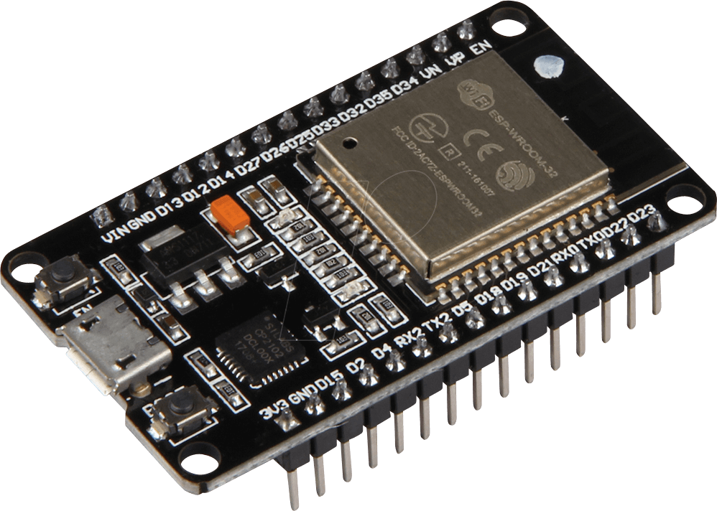
Functional Part: Microcontroller ESP32
The ESP32 is a multiple purpose microcontroller that is used to control and manage all the different components in the system.

Slide 23
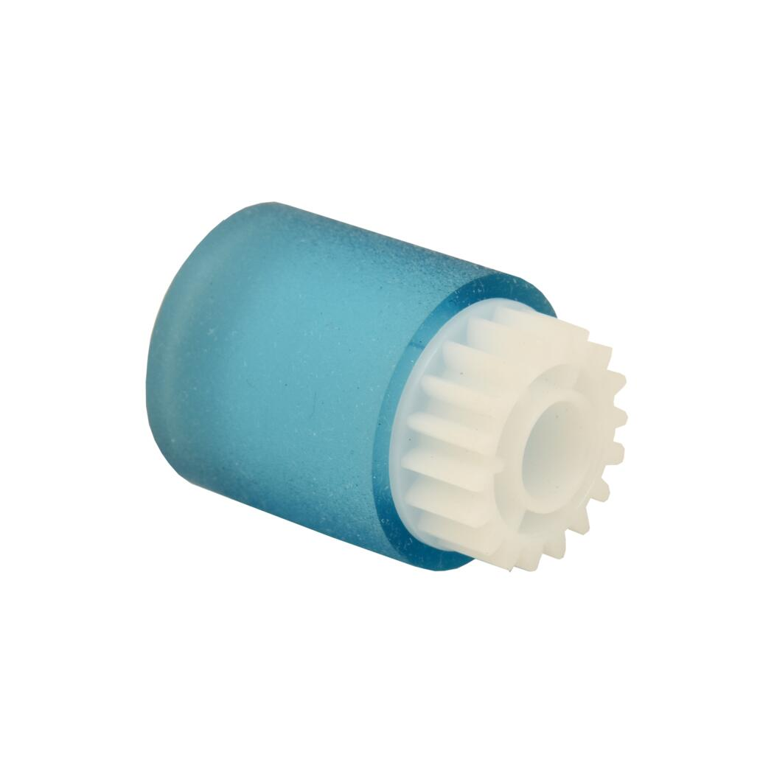
Functional Part: icoh AF03-1081 -Rollers
The Icoh AF03-1081 where originally design for use in epson printers. In our Design they are used to transfer the rotational motion of the motors to the cards

Slide 24
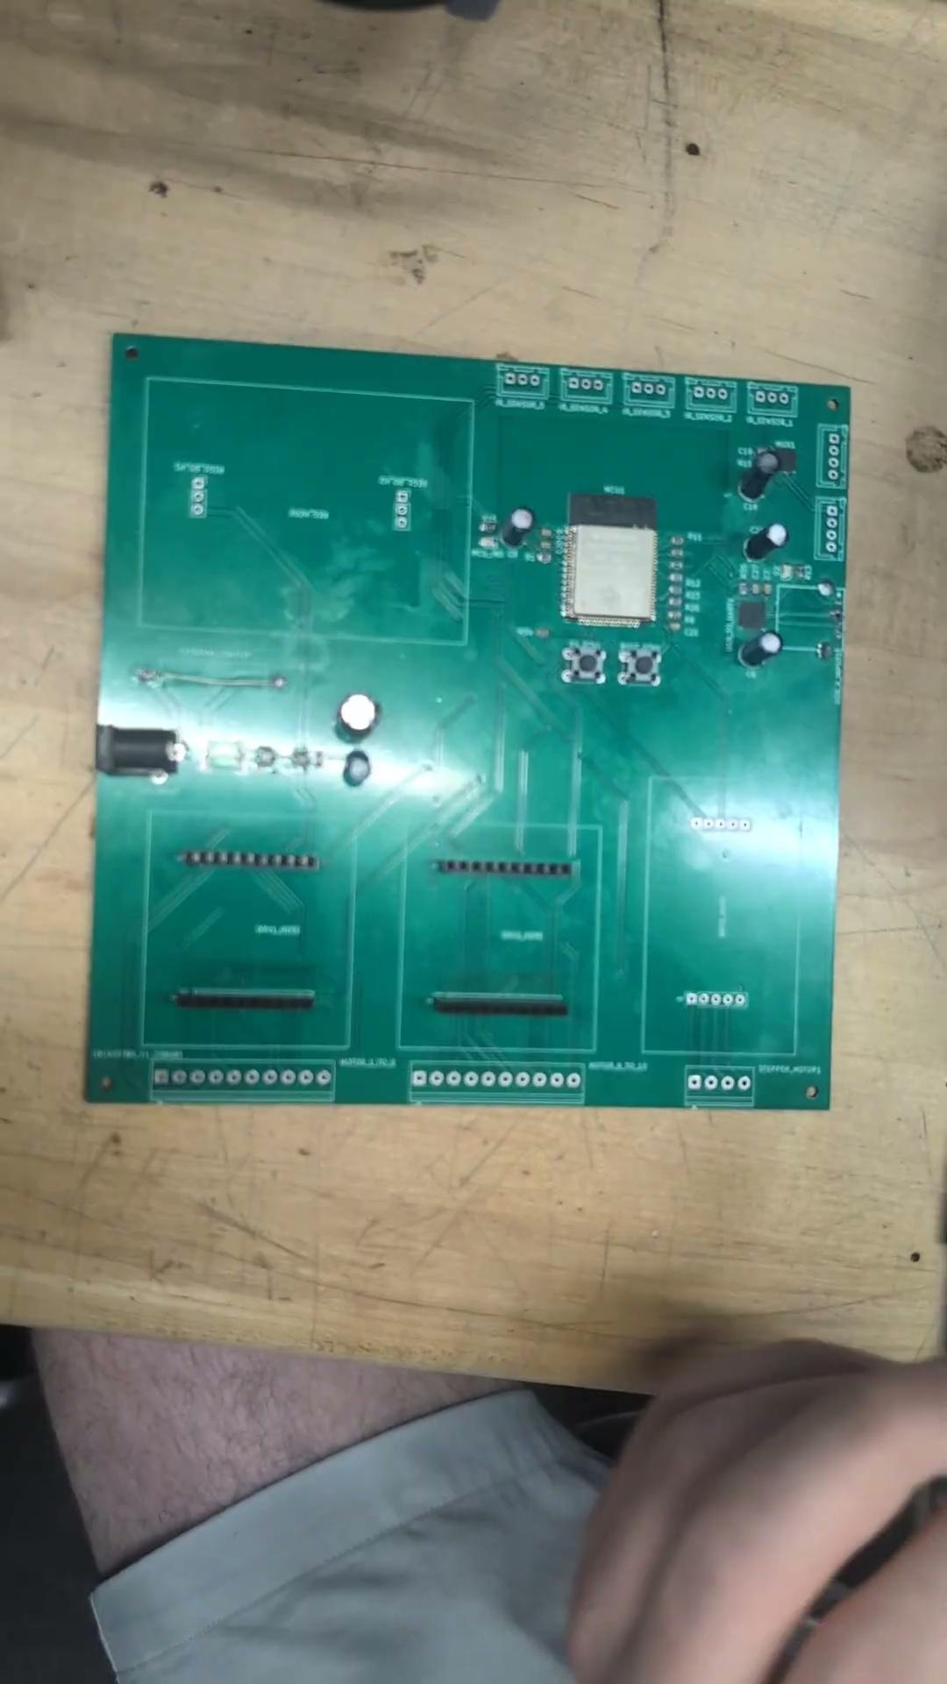
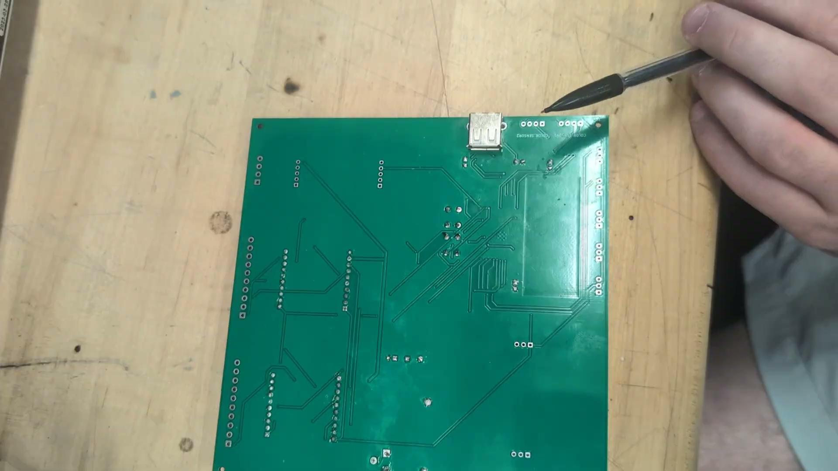
PCB Main board

Slide 25
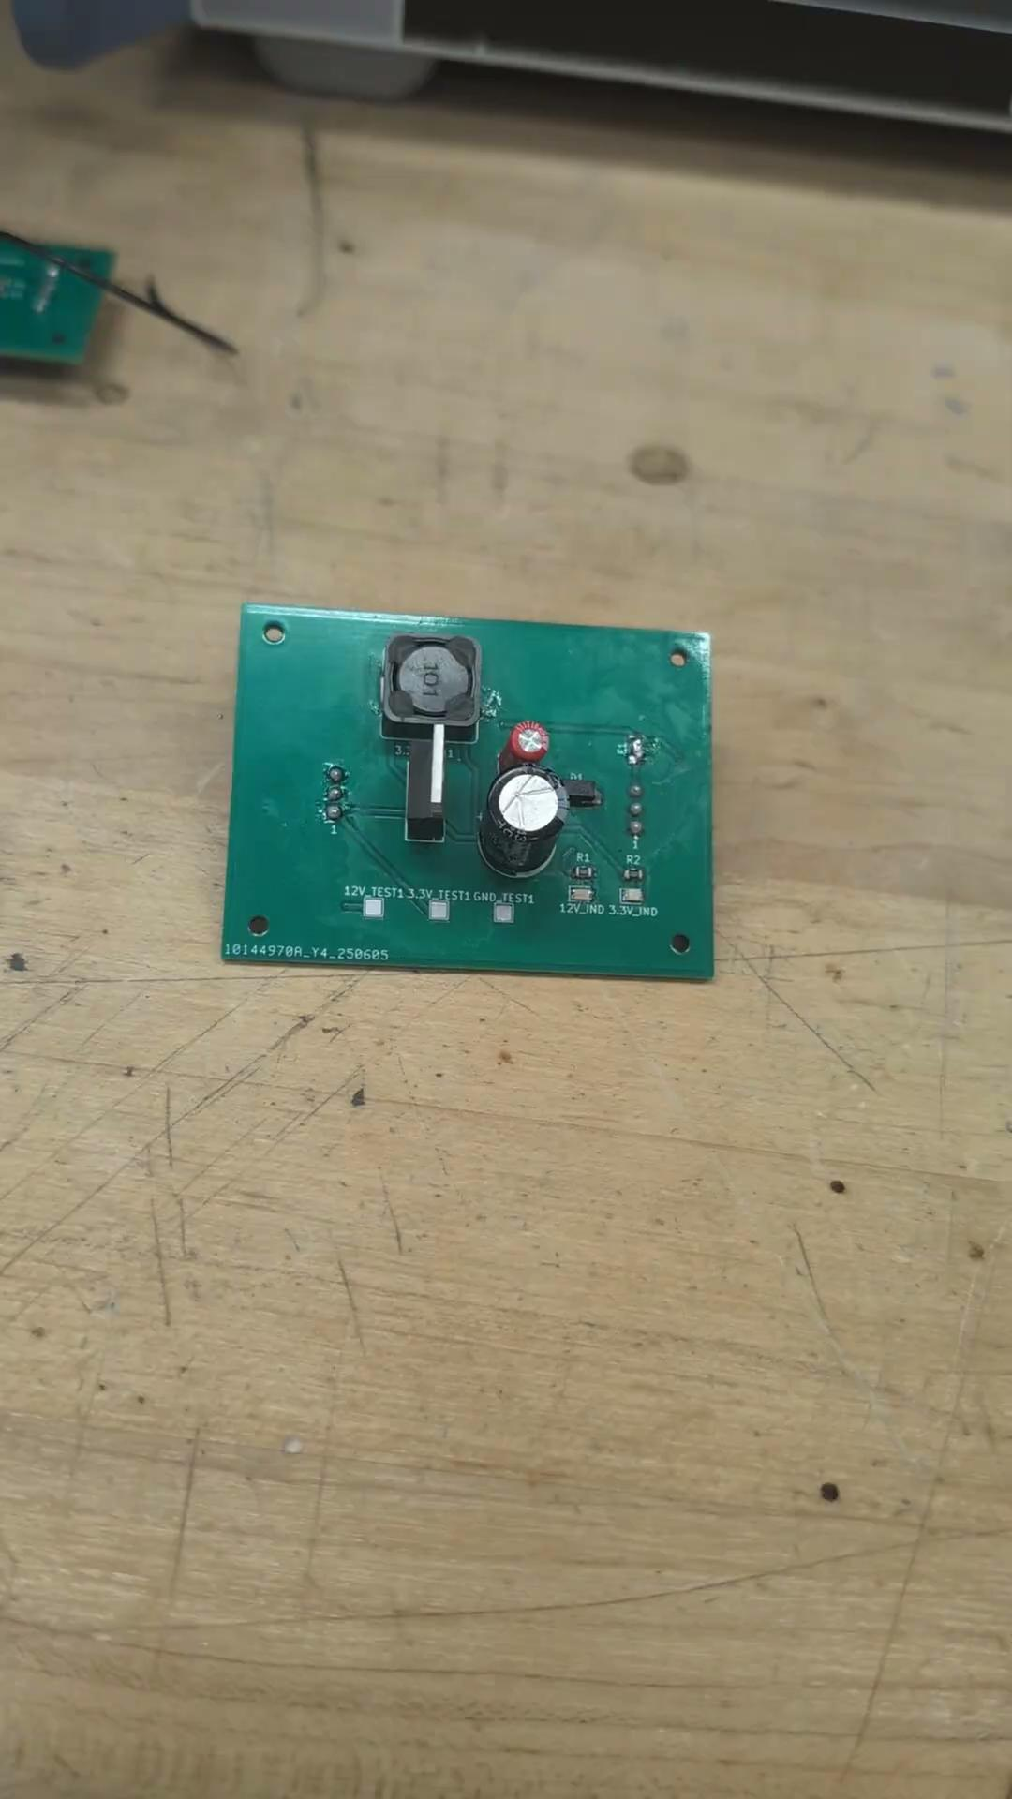
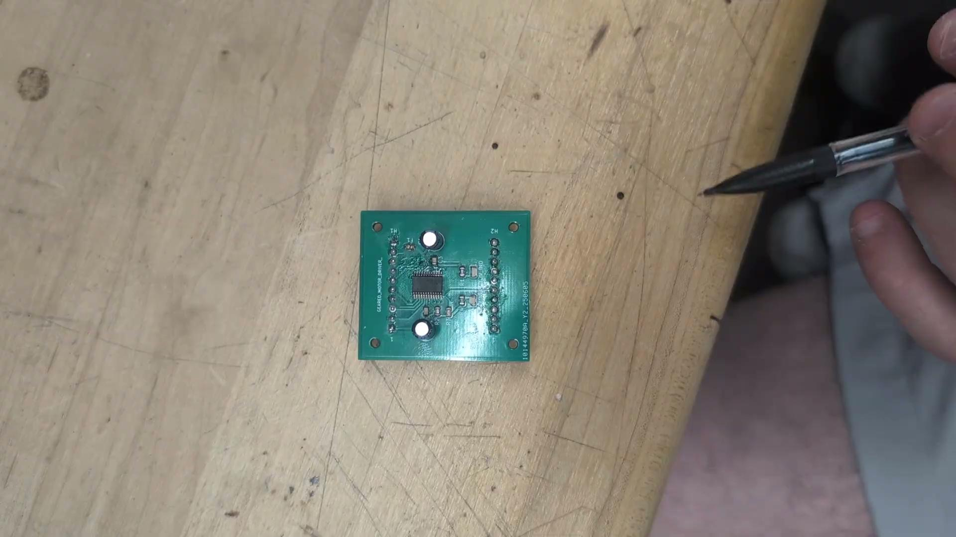
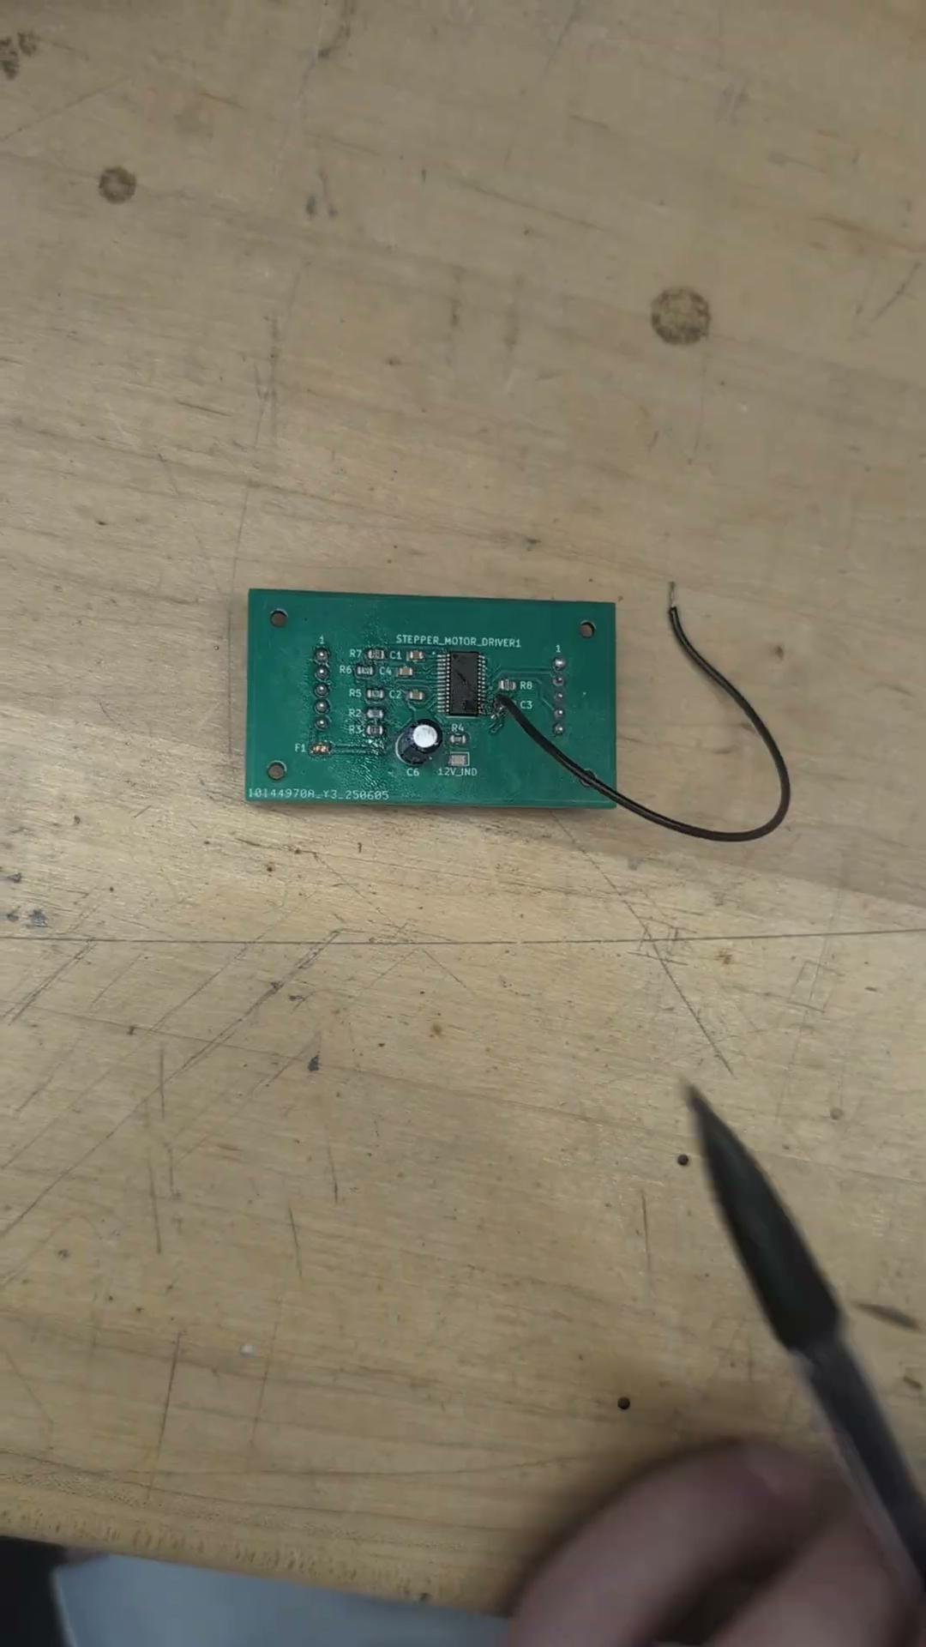
PCB Daughter Board

Slide 26
The End

